Slide 1
Development Tooling - IDEs

Slide 2
Introduction
This presentation will give you an introduction to the specialized text editor software that is invaluable in development work: Integrated Development Environments (IDEs)

Slide 3
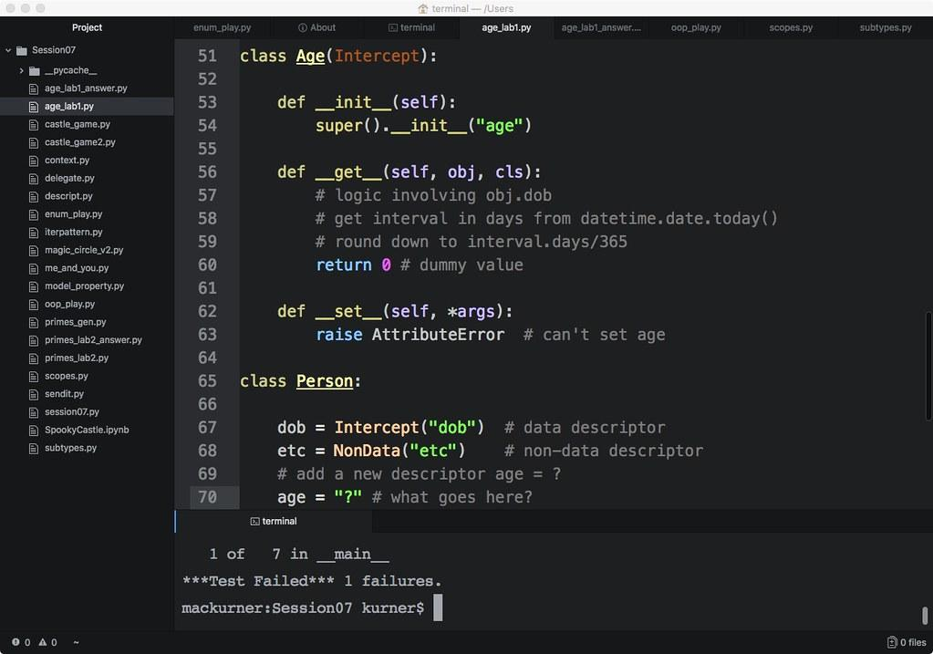
What is an IDE?
All-in-one text editor with built-in tools
Massively enhances developer productivity
Adds features like debugging, code navigation, code generation, and many more

Slide 4
AI-assisted coding
With the breakthrough in Generative AI in 2023, code generation capabilities have been massively upgraded
Generative AI models like ChatGPT, Bard and Claude are capable of generating high-quality code
More specialized solutions for coding like Github Copilot and Amazon CodeWhisperer integrate with IDEs and add many additional features
Cursor AI is the first fully AI-powered IDE

Slide 5
Industry-Standard IDEs
Eclipse: Used mainly for Java, but supports various languages via plugins
IntelliJ IDEA: Comprehensive tool for Java development
PyCharm: Preferred by many Python developers
NetBeans: Another popular Java IDE with support for other languages
Xcode: Essential for iOS and macOS development
Visual Studio: Microsoft flagship IDE for C#, C++, and Visual Basic
Atom: free, open-source, and customizable text editor developed by GitHub with IDE-like features

Slide 6

The Rise of Visual Studio Code
Why Visual Studio Code?
Lightweight and fast
Flexible and extensible
Open-source and free
Built by Microsoft, backed by a large community
Supports virtually every programming language

Slide 7
Language Support in VS Code
Out-of-the-box support for JavaScript, TypeScript, Python, C++, and more
Easily extendable for other languages
Syntax highlighting, linting, and IntelliSense

Slide 8
Extensions and Customizability
Over 20,000 extensions available
Enhance functionality, integrate tools, or add themes
Popular extensions: Python, Docker, GitLens, and Live Share

Slide 9
Versatility of VS Code
Works on Windows, macOS, and Linux
Remote development capabilities
Integrated terminal and Git support

Slide 10
Active Community and Updates
Active user community providing feedback
Monthly updates with new features and improvements
Extensive documentation and community tutorials

Slide 11
Thank you!
Q & A

